Slide 1
WQD7010 Network & Security
Dr. Saaidal Razalli Bin Azzuhri
Dept. of Comp System & Technology
Fac. of Science Comp & IT.

Slide 2
L2: Symmetric Encryption Technique (outline)
Cryptography role in achieving security
Private key (symmetric) encryption in principles
Algorithms of symmetric encryption
Cipher block modes of operation
Stream Ciphers
Key Distribution

Slide 3
Crypthography
Derived from the Greek word Crypto which means hidden
Cryptography refers to the study of mathematical techniques to achieve secure communication
Very important to protect data in transit
– communication channels and IP protocol are insecure
Cryptography is a major technique behind information & network security and a means to achieve
– authentication
– data integrity
– confidentiality
– digital signature
– privacy

Slide 4
Cryptography Techniques
Main cryptographic techniques
- Encryption
- Symmetric encryption
- Asymmetric encryption
- Hash function
Can also be used to protect data in file storage

Slide 5
Symmetric Encryption
Also names as:
- Shared-secret encryption
- Single-key encryption
- Secret-key encryption
- One key encryption
- Private-key encryption
- Shared Key encryption
- Conventional encryption

Slide 6
Encryption & Decryption
Encryption is the transformation of data into a form that is almost impossible to read without the appropriate knowledge
Decryption is the reverse of encryption – the transformation of encrypted data back into an intelligible form
A key or key pair (appropriate knowledge) is necessary for encryption and decryption
– A key is a digital object

Slide 7
Symmetric Encryption
A symmetric encryption scheme has five components:
– plaintext
– encryption algorithm
– a secret key
– ciphertext
– decryption algorithm
Sender and recipient share a common key
Security depends on the secrecy of the key

Slide 8
Symmetric Encryption Components
Five components:
– plaintext - the original message
– ciphertext – the transformed (coded) message
– encryption algorithm - algorithm that transforms
plaintext to ciphertext
– a secret key - information used by the algorithm and known only to sender/receiver
– decryption algorithm – encryption algorithm in
reverse; retrieve original message from coded message

Slide 9
Encryption Example
Original message:
– This is a demonstration of symmetric encryption
Encryption key (128 bit):
– Qwopryoo58gj10pe
Encrypted message:
Decrypted message
– This is a demonstration of symmetric encryption
You may try these simple demos
• https://www.tools4noobs.com/online_tools/encrypt/
• https://www.tools4noobs.com/online_tools/decrypt/

Slide 10
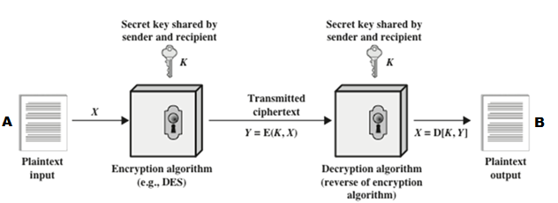
Symmetric Cryptography - Principle
A = Sender
B = Receiver
X = Original Input
K = Secret Key
Y = Ciphertext
E = Encryption Function
D = Decryption Function
A shares a secret key, K with B
A encrypts a plaintext messages X by applying an encryption function E and the key K to create a ciphertext, Y, where Y = E(K, X)
A sends the ciphertext Y to B over a communication channel. Even if anybody other than B gets hold of a copy of Y, he can’t decrypt the message unless he has K.
If the key distribution is perfect or B does not accidently or intentionally disclose it, then nobody other than B is supposed to have K.
On receiving Y, B applies decryption function D and the key K on Y to recover the plaintext message X, where X = D(K, Y)

Slide 11
Cryptanalysis
The process of attempting to discover the plaintext or key is known as cryptanalysis.
An attacker may try different types of attacks on the encrypted message to discover plaintext or secret
A brute-force attacker tries every possible key
On an average a successful break would require half the number of all possible keys tried (meaning that if there are x different keys, on average attacker would discover the actual key after x/2 tries
It is possible to try 1 million keys per μsec.
– requires only ten hours to break a 56-bit symmetric encryption
Higher length key does not necessarily make an encryption more secure, BUT IT WILL MAKE IT MORE DIFFICULT (general rules)
– also depends on the encryption algorithm

Slide 12
Type of Attacks on Encrypted Messages

Slide 13
Exhaustive Key Search / Brute Force Attack
Always possible to simply try every key
Most basic attack, proportional to key size
Assume either know / recognize plaintext

Slide 14
Cipher
Two types:
Stream cipher:
Use a fixed length key to produce a pseudo-random stream of bits (same key gets you the same stream)
XOR those bits with your Plain Text (PT) in order to encrypt
XOR those same bits with your Cipher Text (CT) in order to decrypt
Block cipher:
Use a fixed length key to encrypt a fixed-length block of data
process one input block at a time
produce one output block for each input block

Slide 15
Block Cipher Overview
Block cipher are functions that take an input message and key in order to create a new encrypted ciphertext
The function must be a permutation, meaning a ciphertext can be translated back to plaintext (invertible)
Inversion is basically the same circuit, with function apply in reverse order
Must be efficiently computable

Slide 16
Feistel Cipher
Virtually all conventional block encryption algorithms, including DES (Data Encryption Standard) have a structure first described by Horst Feistel of IBM in 1973
The realization of a Feistel Network depends on the choice of the parameters used and design features

Slide 17
Feistel Cipher Structure
Feistel Cipher operation (see figure in the next slide)
Split the plaintext block into two equal pieces (L₀,R₀)
n rounds of processing for each half before combining to produce ciphertext
For each round i = 1,2,……n
LE_{i} = RE_{i-1} E is encryption
RE_{i} = LE_{i-1}⊕ f(RE_{i-1}, K_{i})
Where f is the round function and K_{i} is the sub-key
After nth round the ciphertext is (LE_{n}, RE_{n}).
Decryption is simply the inverse of encryption, follwing the same steps as above, but reversing the order in which the subkeys are applied.

Slide 18
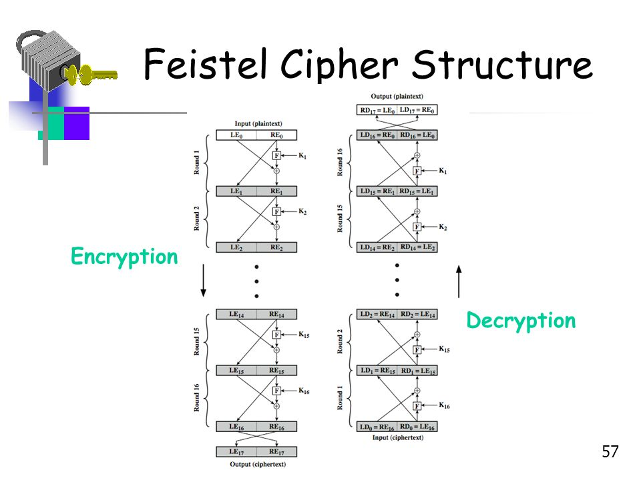
Classical Fiestel Network

Slide 19
Feistel Cipher Parameters
Fiestel Cipher depends on:
Block size: larger block sizes mean greater security
Key Size: larger key size means greater security
Number of rounds: multiple rounds offer increasing security, typically 16 rounds
Subkey generation algorithm: greater complexity will lead to greater difficulty of cryptanalysis.
Round function: greater complexity means greater resistance

Slide 20
Symmetric Encryption Algorithms
Data Encryption Standard (DES)
The most widely used encryption scheme
The algorithm is referred to as the Data Encryption Algorithm (DEA)
DES is a block cipher
- processed in 64-bit blocks
- 56-bits key
- 8 parity bits are stripped off from the full 64-bit key (8 characters)
- 16 subkeys created for 16 rounds
Concern: Proved insecure in today’s fast processing power

Slide 21
DES Basic Operation
DES uses the two basic techniques of cryptography; diffusion and confusion
At the simplest level, diffusion is achieved through numerous permutations and confusion is achieved through the XOR operation

Slide 22
Permutation & Substitution
Permutation
A binary word has its bits reordered (permute)
Also known as P-box
Example: 1st bit may become 7th bit, 2nd bit 12th bit and so on
Substitution
a binary word is replaced/substituted by some other binary word
also known as S-box
impractical to build 64-bit blocks
multiple S-boxes of smaller blocks are used
Example: for an input ’011001’ to an S-box, the output may be ’1001’

Slide 23
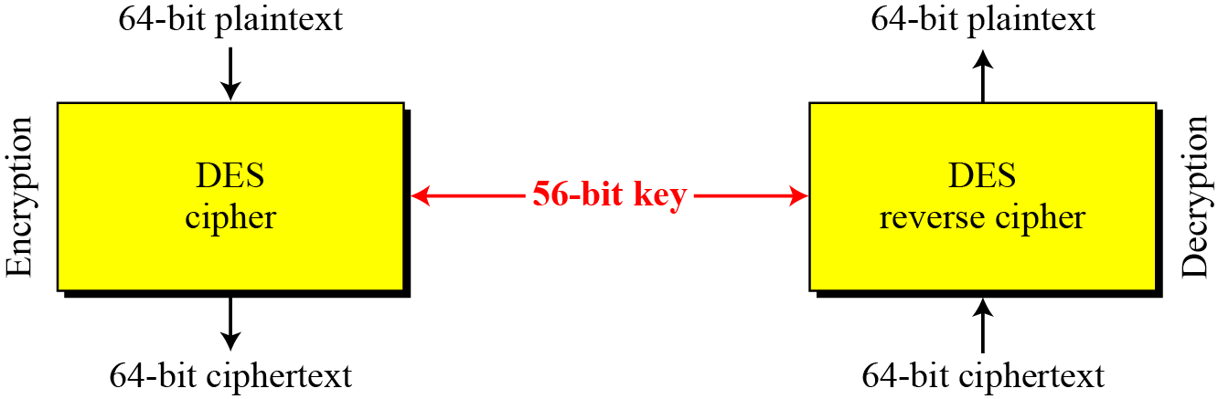
DES – Encryption & Decryption

Slide 24
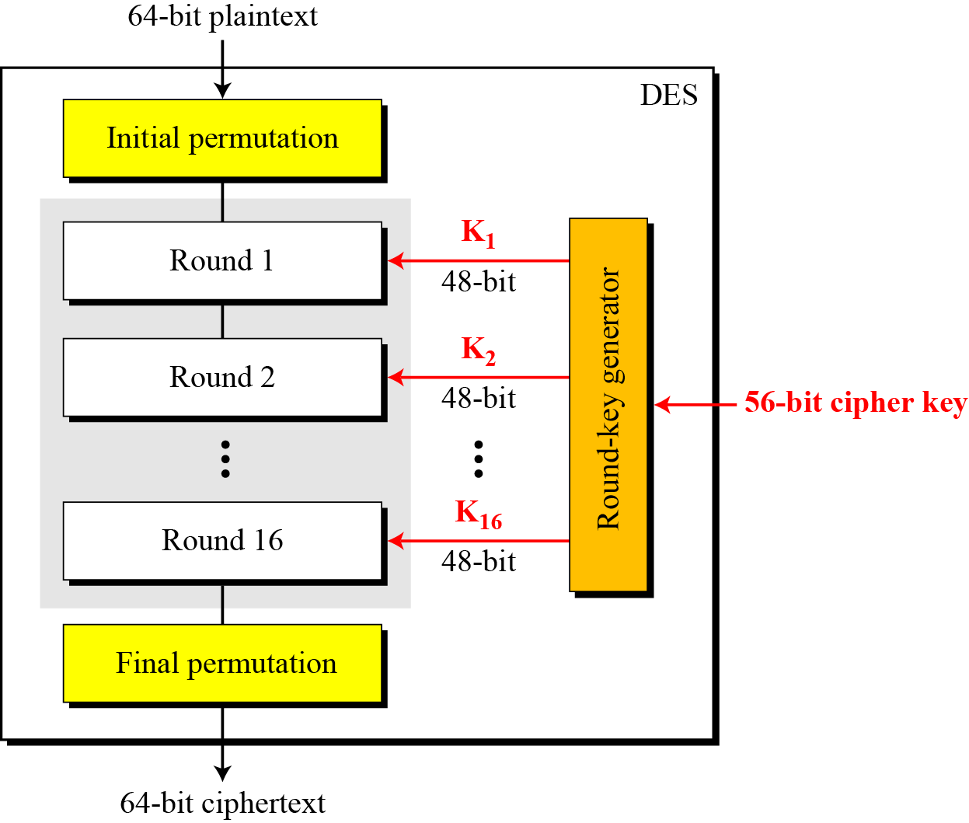
DES Encryption Structure
The encryption process is made of two permutations (P-boxes), which we call initial and final permutations, and sixteen Feistel rounds.

Slide 25
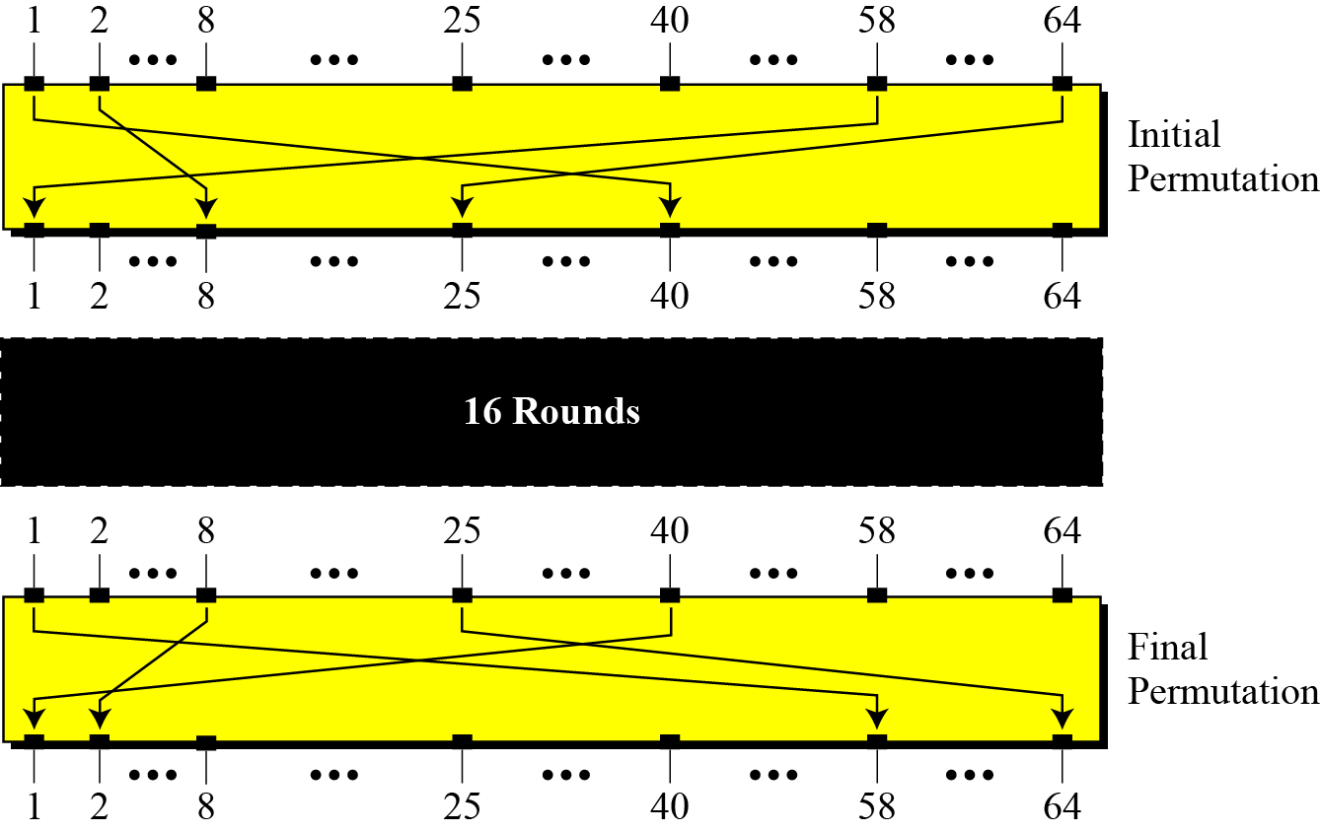
Initial & Final Permutations

Slide 26
Initial & Final Permutations (Table)

Slide 27
Initial & Final Permutations (Example)
Example 2.1
Find the output of the initial permutation box when the input is given in hexadecimal as:
M₁₆ = 0x0000 0080 0000 0002
Solution
Only bit 25 and bit 63 are 1s; the other bits are 0s. In the final permutation, bit 25 becomes bit 37 and bit 63 becomes bit 57. The result is
M₂ = 0000 0000 0000 0000 0000 0000 1000 0000 0000 0000 0000 0000 0000 0000 0000 0010
IP(M₂) = 0000 0000 0000 0000 0000 0000 0000 0000 0000 1000 0000 0000 0000 0000 1000 0000
IP(M₁₆) = 0x0000 0000 0800 0080

Slide 28
Initial & Final Permutations (Example)
Example 2.2
Prove that the initial and final permutations are the inverse of each other by finding the output of the final permutation if the input is
IP(M₁₆) = 0x0000 0000 0800 0080
Solution
The input has only two 1s; the output must also have only two 1s. Using Table from slide 30, we can find the output related to these two bits. Bit 37 in the input becomes bit 25 in the output. Bit 57 in the input becomes bit 63 in the output. So the output has only two 1s, bit 25 and bit 63. The result in hexadecimal is
IP(M₂) = 0000 0000 0000 0000 0000 0000 0000 0000 0000 1000 0000 0000 0000 0000 1000 0000
FP(M₂) = 0000 0000 0000 0000 0000 0000 1000 0000 0000 0000 0000 0000 0000 0000 0000 0010
M₁₆ = 0x0000 0080 0000 0002

Slide 29

Initial & Final Permutations (Example
Note
The initial and final permutations are straight P-boxes that are inverses of each other.
They have no cryptography significance in DES.

Slide 30
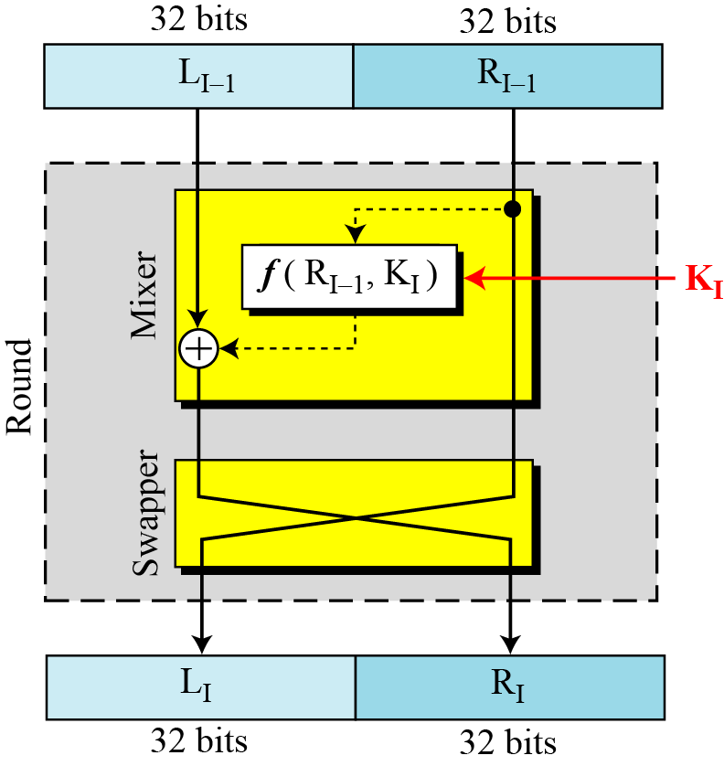
DES Rounds
DES uses 16 rounds. Each round of DES is a Feistel cipher.
A round in DES (encryption site)

Slide 31
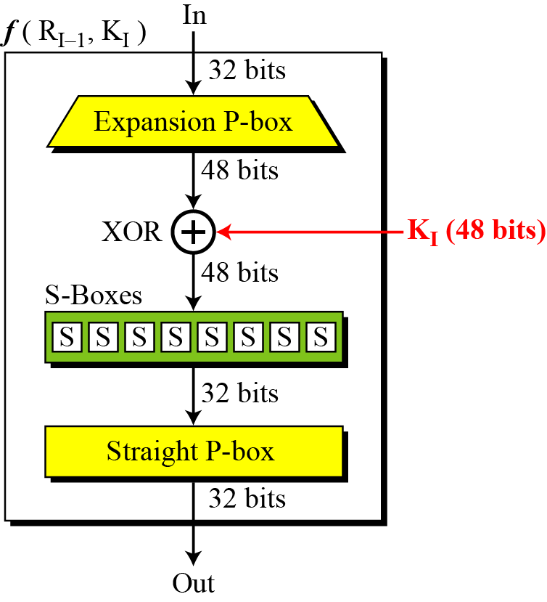
DES Function
The heart of DES is the DES function. The DES function applies a 48-bit key to the rightmost 32 bits to produce a 32-bit output.
DES function

Slide 32
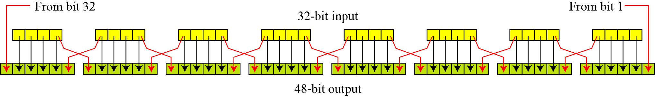
DES – Expansion P-box
Since R_{I−1} is a 32-bit input and K_{I} is a 48-bit key, we first need to expand R_{I−1} to 48 bits. Although the relationship between the input and output can be defined mathematically, DES uses structure and table to define this P-box.

Slide 33
Expansion P-Box Example
Expand the 32-bits input to 48 (Example 2.3)
M₁₆ = 0x0000 0080 0000 0002
IP(M₁₆) = 0x0000 0000 0800 0080
IP(M₂) = 0000 0000 0000 0000 0000 0000 0000 0000 0000 1000 0000 0000 0000 0000 1000 0000
L₀ = 0000 0000 0000 0000 0000 0000 0000 0000
R₀ = 0000 1000 0000 0000 0000 0000 1000 0000
E(R₀) = 000001 010000 000000 000000 000000 000001 010000 000000

Slide 34
DES – Whitener (XOR operation)
After the expansion permutation, DES uses the XOR operation on the expanded right section and the round key.
Note that both the right section and the key are 48-bits in length. Also note that the round key is used only in this operation.
Altogether is 16-sub keys generated for 16 rounds!!

Slide 35
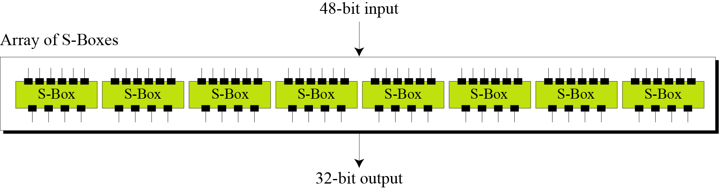
DES – S-boxes
The substitution boxes, or s-boxes do the real mixing (confusion).
DES uses 8 S-boxes, each with a 6-bit input and a 4-bit output. (See Figure below):

Slide 36
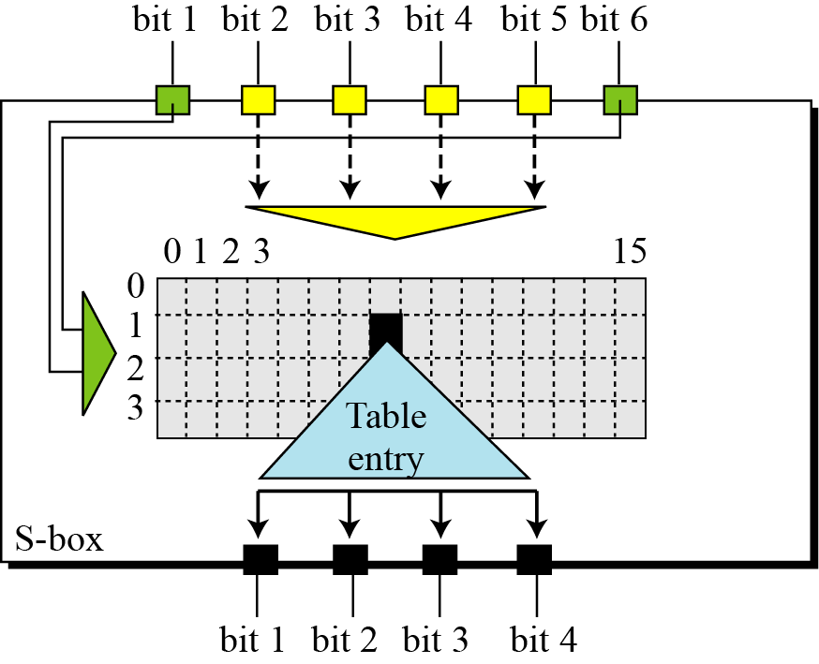
DES – S-box (Rule)

Slide 37
S-Box Substitution Table
Table below shows the permutation for S-box 1.
S-box 1, or S1

Slide 38
S-Box Example
Example 2.4
The input to S-box 1 is 100011. What is the output?
Solution:
If we write the first and the sixth bits together, we get 11 in binary, which is 3 in decimal. The remaining bits are 0001 in binary, which is 1 in decimal. We look for the value in row 3, column 1, in Table S1. The result is 12 in decimal, which in binary is 1100. So the input 100011 yields the output 1100.

Slide 39
S-Box Example
Example 2.5
The input to S-box 1 is 000000. What is the output?
Solution:
If we write the first and the sixth bits together, we get 00 in binary, which is 0 in decimal. The remaining bits are 0000 in binary, which is 0 in decimal. We look for the value in row 0, column 0, in Table S1. The result is 14 in decimal, which in binary is 1110. So the input 000000 yields the output 1110.

Slide 40
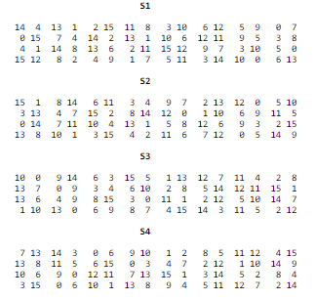
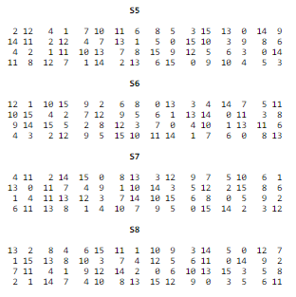
S-Box Table
If the product is K_{n} XOR E(R_{n-1}) =B₁B₂B₃B₄B₅B₆B₇B₈
where each Bi is a group of six bits. We now calculate
S1(B1)S2(B2)S3(B3)S4(B4)S5(B5)S6(B6)S7(B7)S8(B8)
where Si(Bi) referres to the output of the i-th S box.

Slide 41
Straight Permutation Table

Slide 42
DES Sub-Key Generation – round #1
• drop 8 parity bits
− effective key size 56 bits
• permute the bits and divide into two 28-bits
• rotate the bits left by single bit
• permute and extract 48 bits as a subkey

Slide 43
DES Subkey Generation
One bit shift – for
round 1,2,9 and 16
Two bit shift for the
remaining rounds
3,4,5,6,7,8,10,11,12,13,14,15

Slide 44
Key Permutation (Parity-bit Drop) Table
The keys are actually stored as being 64 bits long, but every 8th bit in the key is not used (i.e. bits numbered 8, 16, 24, 32, 40, 48, 56, and 64)
Number of bits shifts

Slide 45
Example of Subkey Generation
From the original 64-bit key
K(Hex) = 133457799BBCDFF1
K = 00010011 00110100 01010111 01111001 10011011 10111100 11011111 11110001
Using the key permutation (parity-bit drop) table, we get the 56-bit permutation:
K+ = 1111000 0110011 0010101 0101111 0101010 1011001 1001111 0001111
Next, split this key into left and right halves, C₀ and D₀, where each half has 28 bits.
Example: From the permuted key K+, we get
C₀ = 1111000 0110011 0010101 0101111 D₀ = 0101010 1011001 1001111 0001111

Slide 46
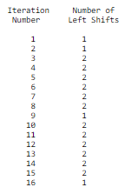
Example of Subkey Generation
From original pair pair C₀ and D₀ we obtain:
C₀ = 1111000011001100101010101111 D₀ = 0101010101100110011110001111
C₁ = 1110000110011001010101011111 D₁ = 1010101011001100111100011110
C₂ = 1100001100110010101010111111 D₂ = 0101010110011001111000111101
C₃ = 0000110011001010101011111111 D₃ = 0101011001100111100011110101

Slide 47
Key Permutation-Compression Table
From 56-bits to 48-bits key

Slide 48
Example of Subkey Compression
Example: For the first and second key we have (56 bits)
C₁D₁ = 1110000 1100110 0101010 1011111 1010101 0110011 0011110 0011110
C₂D₂ = 1100001 1001100 1010101 0111111 0101010 1100110 0111100 0111101
which, after we apply the permutation-compression table, becomes (48-bits)
K₁ = 000110 110000 001011 101111 111111 000111 000001 110010
For the other keys we have
K₂ = 011110 011010 111011 011001 110110 111100 100111 100101 K₃ = 010101 011111 110010 001010 010000 101100 111110 011001

Slide 49
Summary of DES Encryption

Slide 50
Triple DES
The major criticism of DES regards its key length.
Fortunately there are number of alternatives to DES.
This means that we can use triple DES to increase the key size.

Slide 51
Triple DES
Triple-DES is just DES with two 56-bit keys applied.
Given a plaintext message, the first key is used to DES- encrypt the message.
The second key is used to DES-decrypt the encrypted message. (Since the second key is not the right key, this decryption just scrambles the data further).
The twice-scrambled message is then encrypted again with the first key to yield the final ciphertext.
Triple-DES is just DES done three times with two or three keys used in a particular order).

Slide 52
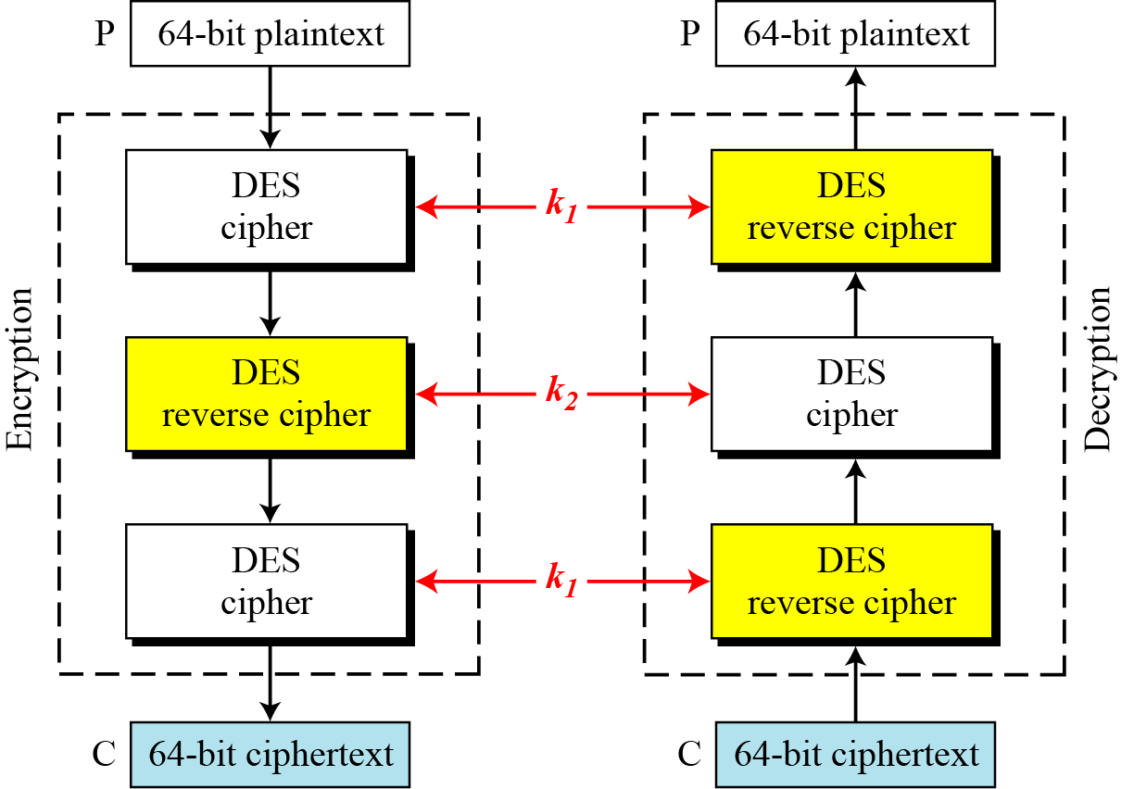
Triple DES Operation (2 keys)

Slide 53
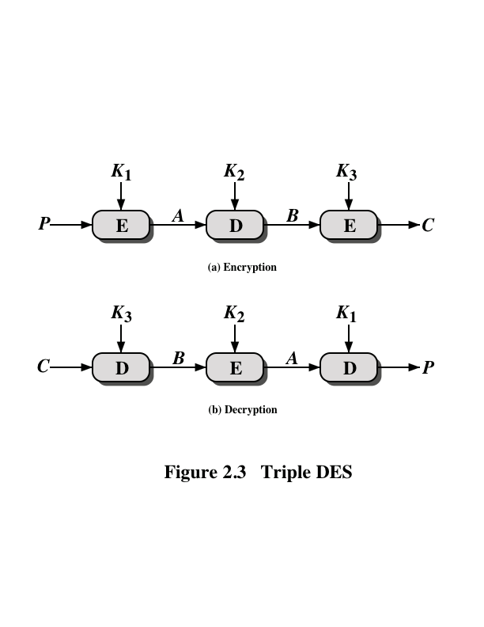
Triple DES Operation (3 Keys)

Slide 54
Security of DES
The use of a 56-bit key for DES
Speed of commercial, off-the-shelf processors threatens the security
Triple DES enjoyed widespread use for few years, but has severe drawbacks:
– slow in software
– use 64-bit block size. A larger length is desirable for efficiency and security
In 1997, US National Institute of Standards and Technology (NIST) officially endorsed Advanced Encryption Standard (AES) to replace DES based on:
– security, computational efficiency, memory requirements, hardware and software suitability, flexibility

Slide 55
Advanced Encryption Standard (AES)
Developed by Joan Daemen and Vincent Rijmen from Belgium – also known
as Rijndael algorithm
The algorithm uses
– 128-bit block cipher with three different key length: 128, 192 and 256 bits & support 10 to 14 rounds
– Design simplicity / flexibility / efficient / fast for both implementations in software and hardware, and code compactness on many CPUs
– It works fast even on small devices such as smart phones, smart cards etc.
– AES provides more security due to larger block size and longer keys.
– AES uses 128 bit fixed block size and works with 128, 192 and 256 bit keys.
– offers lots of flexibility: AES in general is flexible enough to work with key and block size of any multiple of 32 bit with minimum of128 bits and maximum of
256 bits.
– Security: Resistance to power analysis and other implementation attacks

Slide 56
Advanced Encryption Standard (AES)
Main Properties
Block size – 128-bit block size
No of rounds – 10,12 or 14 rounds (just assume 10 rounds for brevity)
Key size – 128-bit or 4 words or 16 bytes (1 word = 32-bit)
No of subkeys – 44 subkeys (or 52 for 12 rounds, or 60 for 14 rounds)
Each subkey size – 32-bit / 1 word / 4 Bytes
Each round - 4 subkeys (128-bit / 4 words / or 16 bytes)
Pre-round calculation – 4 subkeys (128-bit / 4 words / or 16 bytes)

Slide 57
AES Encryption Process
The cipher consists of N rounds, where the number of rounds depends on the key length:
10 rounds for a 16-byte key; 12 rounds for a 24-byte key; and 14 rounds for a 32-byte key.
The first N – 1 rounds consist of four distinct transformation functions: SubBytes, ShiftRows, MixColumns, and AddRoundKey
The final round N contains only 3 transformation functions: SubBytes, ShiftRows, and AddRoundKey
Each transformation takes one or more 4 x 4 matrices as input and produces a 4 x 4 matrix as output.
Key expansion function generates N + 1 round keys, each of which is a distinct 4 x 4 matrix

Slide 58
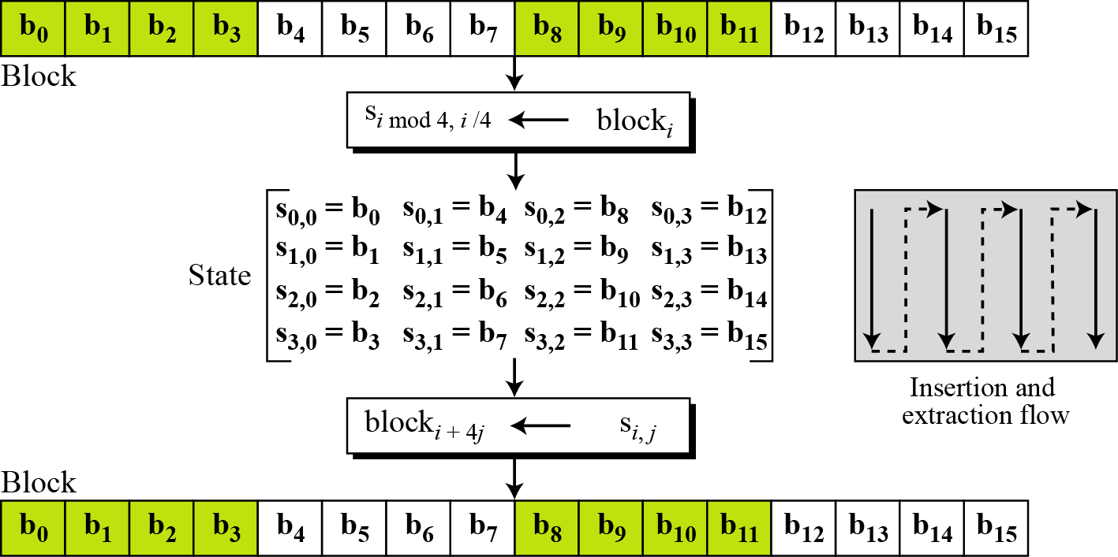
Advanced Encryption Standard (AES)
Block-to-state and state-to-block transformation

Slide 59
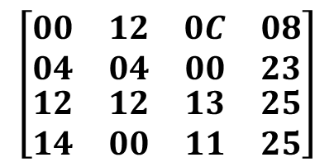
Changing Plaintext to State
Assume the text block is “AES uses a matrix.”
Add to bogus characters ZZ at the end to get a 16-character data block.
Replace each character with an integer between 00 and 25.
Each byte as an integer is now represented with hexadecimal digits.
The state matrix is then filled up, column-by-column as shown.
Text
A E S U S E S A M A T R I X Z Z
Hexadecimal
00 04 12 14 12 04 12 00 0C 00 13 11 08 23 25 25
$$\left[\begin{matrix}\begin{matrix}00 & 12 \\ 04 & 04\end{matrix} & \begin{matrix}0C & 08 \\ 00 & 23\end{matrix} \\ \begin{matrix}12 & 12 \\ 14 & 00\end{matrix} & \begin{matrix}13 & 25 \\ 11 & 25\end{matrix}\end{matrix}\right]$$
State

Slide 60
Advanced Encryption Standard (AES)
Data block of 4 columns of 4 bytes is state
Key is expanded to array of 32-bit words, with number of subkeys corresponds to 10,12 and 14 rounds are 44/52/60
Has N-1 rounds 9/11/13 identical rounds in which state undergoes:
– byte substitution (1 S-box used on every byte)
– shift rows ( simple permutation)
– mix columns (subs using matrix multiply of groups)
– add round key (XOR state with the expanded key words)
– view the whole operation as alternating XOR key & scramble data bytes
Mix columns boxes is not needed for last round (N)

Slide 61
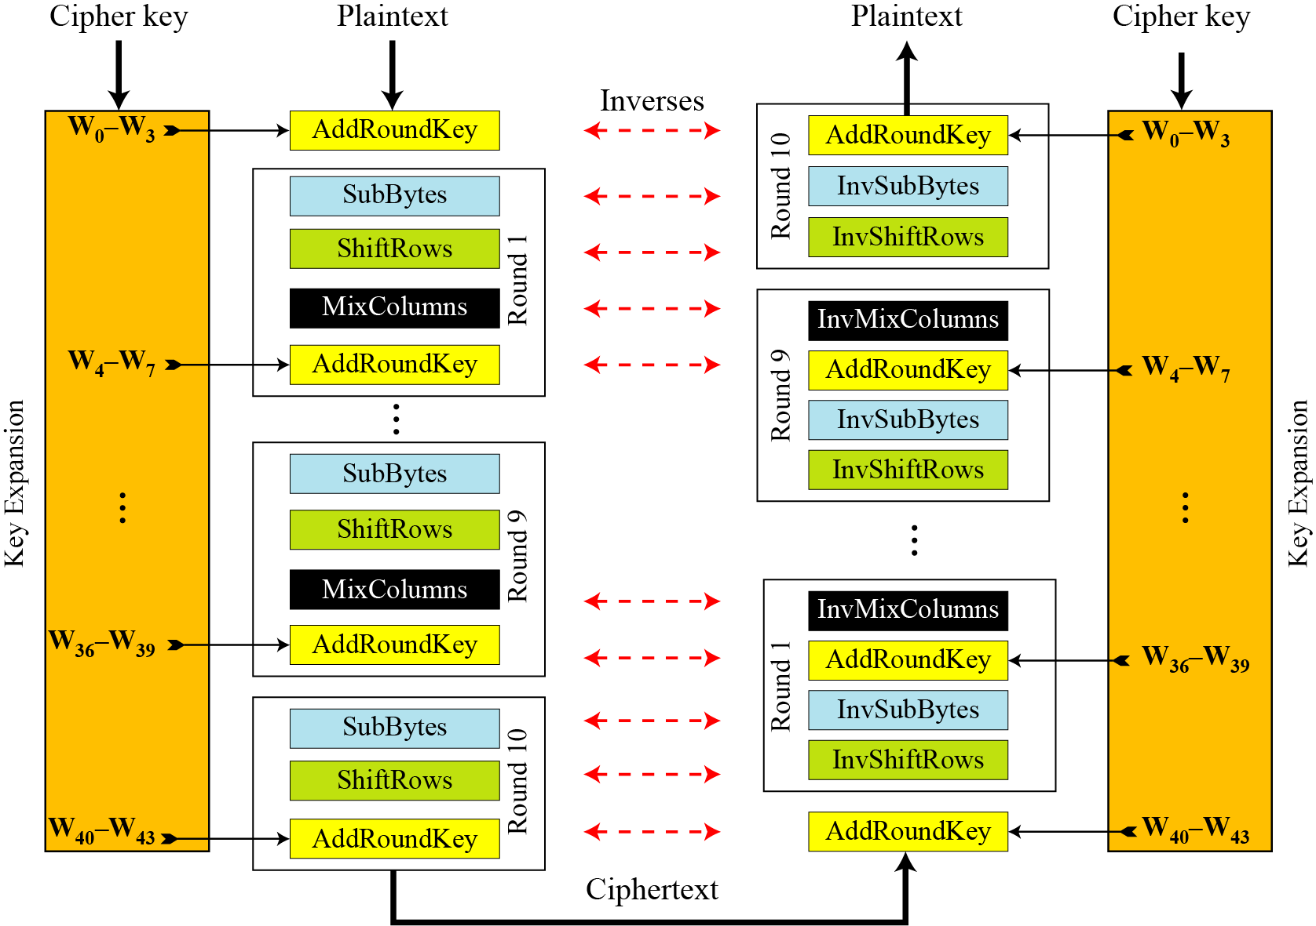
AES Encryption and Decryption

Slide 62
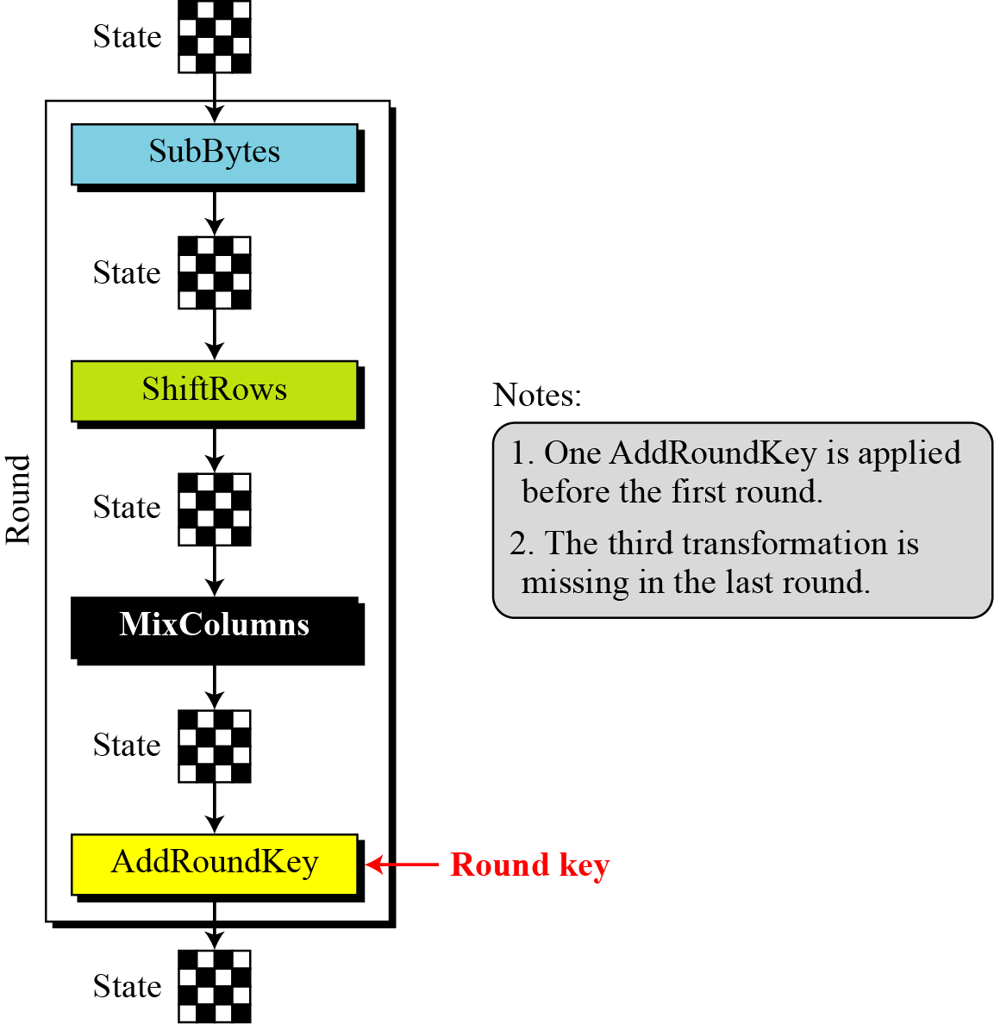
AES Single Round

Slide 63

Step-by-step solution of AES
Given the plaintext, key and ciphertext:
PT = 0123456789abcdeffedcba9876543210
Key = 0f1571c947d9e8590cb7add6af7f6798
First, we are going to solve the key generation (up to round 1 only!!)

Slide 64

Key Expansion in AES
Steps:
Put in 4 words, each words is 32-bits, in a group of 8-bits
Rotate w(3), the last word with one shift to the left, the new column will become x(1)
Use SubBytes box to bits-rearrangement for x(1), output becoming y(1)
Add y(1) to the Round Constant (Rcon) which table is provided below (only for the first 8-bits, other remains unchanged):
y1 ⊕ Rcon = z1

Slide 65
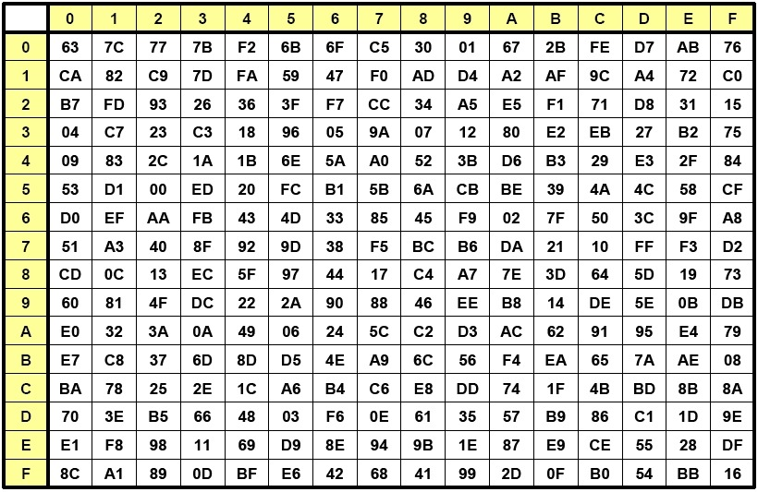
Key Expansion in AES
Key = 0f1571c947d9e8590cb7add6af7f6798
Put in group of 4:
Key = 0f1571c9 47d9e859 0cb7add6 af7f6798
Rearrange for w0 to w3
w(0) = 0f 15 71 c9, w(1) = 47 d9 e8 59, w(2) = 0c b7 ad d6, w(3) = af 7f 67 98
For w(3), rotate 1-position to the left
w(3) = af 7f 67 98, Rot(w(3)) = x(1) = 7f 67 98 af
Use substitution bytes box to obtain SubBytes output
Sub(x(1)) = y(1) = d2 85 46 79
Add with round constant (Rcon(1)), where three rightmost bytes are zero
Rcon(1) = 01 00 00 00, z(1) = y(1) ⊕ Rcon(1)

Slide 66
Key Expansion in AES
Key = 0f1571c947d9e8590cb7add6af7f6798
Rcon Table:
Rcon(1) = 01 00 00 00, z(1) = y(1) ⊕ Rcon(1)
Rcon(1) = 01 00 00 00
y(1) = d2 85 46 79
Only XOR 01 and d2, which both represented in hexadecimal, other three bytes will be the same, since it is XOR with zero
(01 ⊕ d2)hex = (0000 0001 ⊕ 1101 0010)bin ➔ 0000 0001
⊕ 1101 0010
= (1101 0011)bin = (d3)hex
z(1) = d3 85 46 79

Slide 67
AES Key Expansion

Slide 68
AES Key Expansion (Round 1)
Round 1 (i = 1)
For w(xi) = w(i-1) ⊕ z(i), x = 4
For w(x) = w(x-1) ⊕ w(x-4)
For round 1, the expansion key calculation will looks like this:

Slide 69
AES Key Expansion (Round 1)
w4 = w0 ⊕ z1
= 0f 15 71 c9 ⊕ d3 85 46 79
0000 1111 0f 0001 0101 15 0111 0001 71 1100 1001 c9
1101 0011 d3 1000 0101 85 0100 0110 46 0111 1001 79
1101 1100 1001 0000 0011 0111 1011 0000
d c 9 0 3 7 b 0
The complete calculation:

Slide 70
AES Key Expansion (Round 1)
Take w(7)
Do the process as in slide number 64
For w(7), rotate 1-position to the left
w(7) = 38 81 15 a7, Rot(w(7)) = x(2) = 81 15 a7 38
Use substitution bytes box to obtain SubBytes output
Sub(x(2)) = y(2) = 0c 59 5c 07
Add with round constant (Rcon(2))
Rcon(2) = 02 00 00 00, z(2) = y(2) ⊕ Rcon(2)

Slide 71
AES Key Expansion (Round 1)
Rcon(2) = 02 00 00 00, z(2) = y(2) ⊕ Rcon(2)
Rcon(2) = 02 00 00 00
y(2) = 0c 59 5c 07
Only XOR 02 and 0c, which both represented in hexadecimal, other three bytes will be the same, since it is XOR with zero
(02 ⊕ 0c)hex = (0000 0010 ⊕ 0000 1100)bin ➔ 0000 0010
0000 1100
= (0000 1110)bin = (0e)hex
z(2) = 0e 59 5c 07
Do the same with the rest of the key from round 2 to 10!!

Slide 72
Plaintext and Round Key (Round 0)
For round 0, we do the add round key (PT XOR with Key in round 0, in state matrix)
PT = 01 23 45 67 89 ab cd ef fe dc ba 98 76 54 32 10
Represented in state matrix:
PT = K =
PT ⊕ K (convert hex to binary, do the XOR operation in binary!!)
➔
01⊕0f | 89⊕47 | fe⊕0c | 76⊕af
23⊕15 | ab⊕d9 | dc⊕b7 | 54⊕7f
45⊕71 | cd⊕e8 | ba⊕ad | 32⊕67
67⊕c9 | ef⊕59 | 98⊕d6 | 10⊕98

Slide 73
Plaintext and Round Key (Round 1) - SubBytes
The order of the AES:
SubBytes => ShiftRow => MixColumn => AddRoundKey
We will look on SubBytes first, refer to SubBytes box
Output from Add Round Key from Round 0:
after SubBytes
Look 0e (row 0 and column e), will return ab, similarly 36 (row 3, column 6), will return 05 and so on…..

Slide 74
Plaintext and Round Key (Round 1) - ShiftRow
For Shift Row operation, the rules are as follows:
Row 1 = no change
Row 2 = shift 1 to the left
Row 3 = shift 2 to the left
Row 4 = shift 3 to the left
From will become

Slide 75
Plaintext and Round Key (Round 1) – MixColumn
Mix Column operation is the most extensive calculation of all AES operations
It follows the finite Galuis Field, GF(2⁸) or GF(x⁸)
The mathematical details are beyond the scope of this subject, but the final formulation is important to do the mathematical operation of Mix column
The basic formula to do the calculation in Mix Column is based on GF(x⁸), given as follows:
Where x = 2 or 02 in hex, and 0000 0010 in binary (don’t worry, we will see the example of how this formula is used)

Slide 76
Plaintext and Round Key (Round 1) – MixColumn
Before we start, several rules that are important for this operation:
Anything that is multiplied with (01)hex or (0000 0001)binary, will return the same value, e.g => 01 x dc, the output will be dc
03 x f(x), where f(x) is hex representation of plaintext, can be written as:
03 x f(x) = [02 x f(x)] ⊕ [01 x f(x)] = [0.2 x f(x)] ⊕ f(x)
Example: 03 x dc = [02 x dc] ⊕ [01 x dc] = [02 x dc] ⊕ dc
Will return f(x) since multiplied with 01

Slide 77
Plaintext and Round Key (Round 1) – MixColumn
We will begin operation with Mix Column matrix:
This constant matrix is used in every round (except the last one)
Recall
From to using ShiftRow
(The output we will multiplied with Mix column Matrix)

Slide 78
Plaintext and Round Key (Round 1) – MixColumn
The operation
X Row at mix column matrix times the column of plaintext
The multiplication method:
02.ab⊕03.40⊕01.f0⊕01.c4 | 02.8b⊕03.7f⊕01.fc⊕01.e4 | 02.89⊕03.f1⊕01.18⊕01.4e | 02.35⊕03.05⊕01.3f⊕01.2f
01.ab⊕02.40⊕03.f0⊕01.c4 | 01.8b⊕02.7f⊕03.fc⊕01.e4 | 01.89⊕02.f1⊕03.18⊕01.4e | 01.35⊕02.05⊕03.3f⊕01.2f
01.ab⊕01.40⊕02.f0⊕03.c4 | 01.8b⊕01.7f⊕02.fc⊕03.e4 | 01.89⊕01.f1⊕02.18⊕03.4e | 01.35⊕01.05⊕02.3f⊕03.2f
03.ab⊕01.40⊕01.f0⊕02.c4 | 03.8b⊕01.7f⊕01.fc⊕02.e4 | 03.89⊕01.f1⊕01.18⊕02.4e | 03.35⊕01.05⊕01.3f⊕02.2f

Slide 79
Plaintext and Round Key (Round 1) – MixColumn
We will do the first row and first column multiplication operation, mark with red font in previous slide:
Row 1, column 1 (S’_{0,0}) = 02.ab⊕03.40⊕01.f0⊕01.c4
The first one:
02.ab
We can use equation where x = 02 remove
Concentrate on ab, which is in hex, next step is to convert to binary: 1 0 1 0 1 0 1 1
b7 b6 b5 b4 b3 b2 b1 b0
ab = 1010 1011 => 1 0 1 0 1 0 1 1, where b7 is 1
0 1 0 1 0 1 1 0
Before XOR output: 0 1 0 1 0 1 1 0
Based on the equation, where b7 = 1, add 0 at the end

Slide 80
Plaintext and Round Key (Round 1) – MixColumn
From the equation, since b7 is 1, we have to XOR our operation with (00011011)bin
From the final output from previous slide (0101 0110), we XOR with 0001 1011)
0101 0110 ⊕ 0001 1011
0101 0110
0001 1011
0100 1101 for 02.ab based on equation!!
Next is 03.40 => where we can write as 02.40 ⊕ 01.40 = 02.40 ⊕ 40
02.40 => concentrate on 40 = 0 1 0 0 0 0 0 0
b7 b6 b5 b4 b3 b2 b1 b0
Since bit 7 is 0, we can just remove b7, and add 0 at the end (b6 b5 b4 b3 b2 b1 b0 0)

Slide 81
Plaintext and Round Key (Round 1) – MixColumn
02.40
40 => 0 1 0 0 0 0 0 0
Remove 1 0 0 0 0 0 0 0
Final output = 1000 0000
It’s not yet finish, we have to XOR with 40, remember 02.40 ⊕ 40, we only finish the first part, 02.40
1000 0000 ⊕ (40)hex = 1000 0000 ⊕ 0100 0000 = 1100 0000
Back to = 02.ab⊕03.40⊕01.f0⊕01.c4, when multiplied with 1, return the same value. 01.fo will be fo, and 01.c4 will be c4.
0 is added at the end

Slide 82
Plaintext and Round Key (Round 1) – MixColumn
02.ab⊕03.40⊕01.f0⊕01.c4
02.ab = 0 1 0 0 1 1 0 1
03.40 = 1 1 0 0 0 0 0 0
01.f0 = 1 1 1 1 0 0 0 0
01.c4 = 1 1 0 0 0 1 0 0
1 0 1 1 1 0 0 1
b 9
The final output of mix column process, where we only calculate for b9
To do the XOR operation for more than two inputs, the rules are:
If all 0s or 1s, output is 0
If two 0s and two 1s, output is 0
If single 1 or three 1s, output is 1
02.ab = 0 1 0 0 1 1 0 1
03.40 = 1 1 0 0 0 0 0 0
01.f0 = 1 1 1 1 0 0 0 0
01.c4 = 1 1 0 0 0 1 0 0
1 0 1 1 1 0 0 1
b 9

Slide 83
Plaintext and Round Key (Round 1) – Add Round Key
Add round key is a similar process to round zero add round key.
Recall:
Is actually aligned with the state matrix as follow:
XOR with Mix Column for final output

Slide 84
Plaintext and Round Key (Round 1) – Add Round Key
dc ⊕ b9
dc = 1101 1100
b9 = 1011 1001
0110 0101
6 5
Final output of round 1, goes to round 2 as input:

Slide 85
AES Security
AES was designed after DES. Most of the known attacks on DES were already tested on AES.
Brute-Force Attack
AES is definitely more secure than DES due to the larger-size key.
Statistical Attacks
Numerous tests have failed to do statistical analysis of the ciphertext.
Differential and Linear Attacks
There are no differential and linear attacks on AES as yet.

Slide 86
AES Advantage
AES can be implemented in software, hardware, and firmware. The implementation can use table lookup process or routines that use a well-defined algebraic structure
The algorithms used in AES are so simple that they can be easily implemented using cheap processors and a minimum amount of memory.

Slide 87
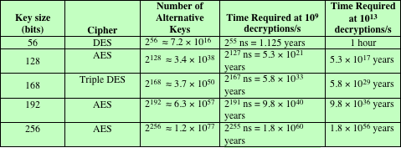
Average Time Required for Exhaustive Key Search

Slide 88
Cipher block Modes of Operation
A symmetric block cipher processes one block of data at a time
In the case of DES and 3DES, the block length is b=64 bits
For AES, the block length is b=128
For longer amounts of plaintext, it is necessary to break the plaintext into b-bit blocks, padding the last block if necessary
Five modes of operation have been defined by NIST
Intended to cover virtually all of the possible applications of encryption for which a block cipher could be used
Intended for use with any symmetric block cipher, including triple DES and AES
Notes:
A symmetric block cipher processes one block of data at a time. In the case of
DES and 3DES, the block length is b = 64 bits; for AES, the block length is
b = 128 bits. For longer amounts of plaintext, it is necessary to break the plaintext
into b -bit blocks (padding the last block if necessary). To apply a block cipher in a
variety of applications, five modes of operation have been defined by NIST
(Special Publication 800-38A). The five modes are intended to cover virtually all
of the possible applications of encryption for which a block cipher could be used.
These modes are intended for use with any symmetric block cipher, including triple
DES and AES. The most important modes are described briefly in the remainder
of this section.

Slide 89
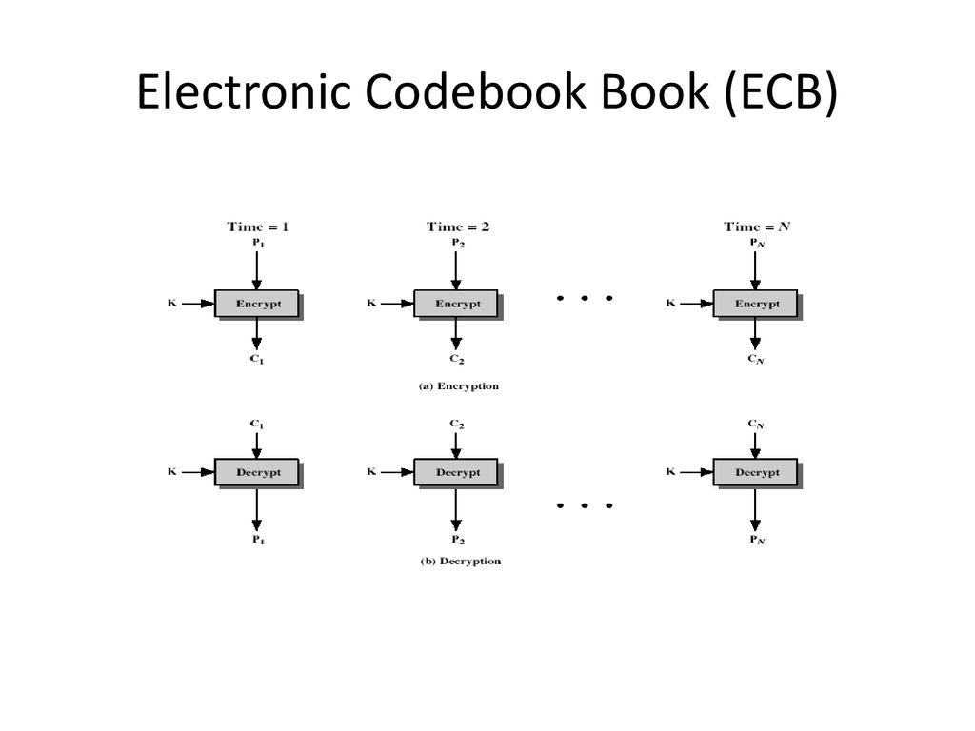
Electronic Codebook Mode (ECB)
Plaintext is handled b bits at a time and each block of plaintext is encrypted using the same key
The term “codebook” is used because, for a given key, there is a unique ciphertext for every b-bit block of plaintext
One can imagine a gigantic codebook in which there is an entry for every possible b-bit plaintext pattern showing its corresponding ciphertext
With ECB, if the same b-bit block of plaintext appears more than once in the message, it always produces the same ciphertext
Because of this, for lengthy messages, the ECB mode may not be secure
If the message is highly structured, it may be possible for a cryptanalyst to exploit these regularities
Notes:
The simplest way to proceed is using what is known as electronic codebook (ECB)
mode , in which plaintext is handled b bits at a time and each block of plaintext is
encrypted using the same key. The term codebook is used because, for a given key,
there is a unique ciphertext for every b -bit block of plaintext. Therefore, one can
imagine a gigantic codebook in which there is an entry for every possible b -bit plaintext
pattern showing its corresponding ciphertext.
With ECB, if the same b -bit block of plaintext appears more than once in
the message, it always produces the same ciphertext. Because of this, for lengthy
messages, the ECB mode may not be secure. If the message is highly structured,
it may be possible for a cryptanalyst to exploit these regularities. For example,
if it is known that the message always starts out with certain predefined fields,
then the cryptanalyst may have a number of known plaintext–ciphertext pairs to
work with. If the message has repetitive elements with a period of repetition a
multiple of b bits, then these elements can be identified by the analyst. This may
help in the analysis or may provide an opportunity for substituting or rearranging
blocks.
To overcome the security deficiencies of ECB, we would like a technique in
which the same plaintext block, if repeated, produces different ciphertext blocks.

Slide 90
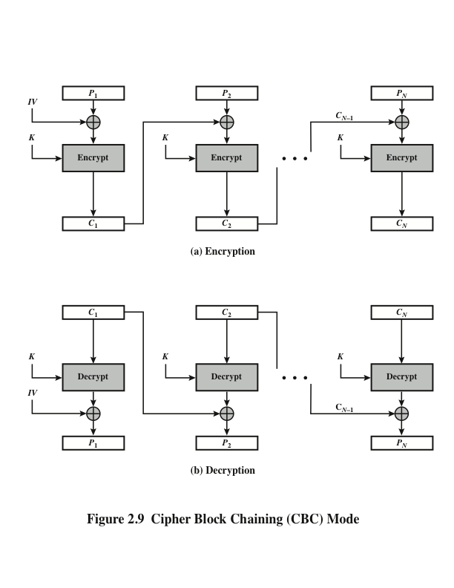
Notes:
In the cipher block chaining (CBC) mode (Figure 2.9), the input to the encryption
algorithm is the XOR of the current plaintext block and the preceding ciphertext
block; the same key is used for each block. In effect, we have chained together the
processing of the sequence of plaintext blocks. The input to the encryption function
for each plaintext block bears no fixed relationship to the plaintext block. Therefore,
repeating patterns of b bits are not exposed.
For decryption, each cipher block is passed through the decryption algorithm.
The result is XORed with the preceding ciphertext block to produce the plaintext
block.
To produce the first block of ciphertext, an initialization vector (IV) is XORed
with the first block of plaintext. On decryption, the IV is XORed with the output of
the decryption algorithm to recover the first block of plaintext.
The IV must be known to both the sender and receiver. For maximum security,
the IV should be protected as well as the key. This could be done by sending
the IV using ECB encryption. One reason for protecting the IV is as follows: If an
opponent is able to fool the receiver into using a different value for IV, then the
opponent is able to invert selected bits in the first block of plaintext.

Slide 91
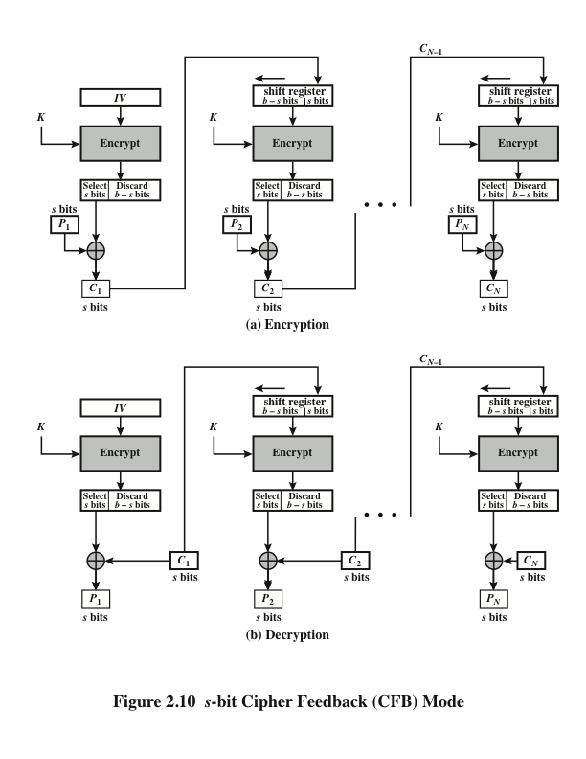
Notes:
It is possible to convert any block cipher into a stream cipher by using the cipher
feedback (CFB) mode . A stream cipher eliminates the need to pad a message to
be an integral number of blocks. It also can operate in real time. Thus, if a character
stream is being transmitted, each character can be encrypted and transmitted
immediately using a character-oriented stream cipher.
One desirable property of a stream cipher is that the ciphertext be of the same
length as the plaintext. Thus, if 8-bit characters are being transmitted, each character
should be encrypted using 8 bits. If more than 8 bits are used, transmission
capacity is wasted.
Figure 2.10 depicts the CFB scheme. In the figure, it is assumed that the unit
of transmission is s bits; a common value is s = 8. As with CBC, the units of plaintext
are chained together, so that the ciphertext of any plaintext unit is a function of
all the preceding plaintext.

Slide 92
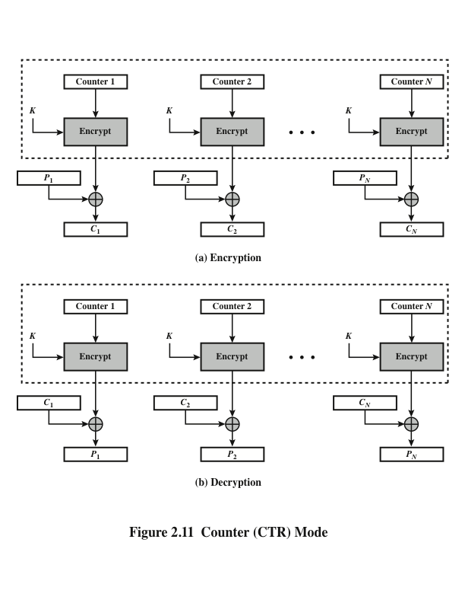
Notes:
Although interest in the counter mode (CTR) has increased recently, with applications
to ATM (asynchronous transfer mode) network security and IPSec (IP security),
this mode was proposed early on (e.g., [DIFF79]).
Figure 2.11 depicts the CTR mode. A counter equal to the plaintext block
size is used. The only requirement stated in SP 800-38A is that the counter value
must be different for each plaintext block that is encrypted. Typically, the counter
is initialized to some value and then incremented by 1 for each subsequent block
(modulo 2^{b} , where b is the block size). For encryption, the counter is encrypted and
then XORed with the plaintext block to produce the ciphertext block; there is no
chaining. For decryption, the same sequence of counter values is used, with each
encrypted counter XORed with a ciphertext block to recover the corresponding
plaintext block.

Slide 93
Advantages of CTR mode
Hardware efficiency
Encryption/decryption can be done in parallel on multiple blocks of plaintext or ciphertext
Throughput is only limited by the amount of parallelism that is achieved
Software efficiency
Because of the opportunities for parallel execution, processors that support parallel features can be effectively utilized
Preprocessing
The execution of the underlying encryption algorithm does not depend on input of the plaintext or ciphertext --- when the plaintext or ciphertext input is presented, the only computation is a series of XORs, greatly enhancing throughput
Random access
The ith block of plaintext or ciphertext can be processed in random-access fashion
Provable security
It can be shown that CTR is at least as secure as the other modes discussed in this section
Simplicity
Requires only the implementation of the encryption algorithm and not the decryption algorithm
Notes:
[LIPM00] lists the following advantages of CTR mode.
• Hardware efficiency: Unlike the chaining modes, encryption (or decryption)
in CTR mode can be done in parallel on multiple blocks of plaintext or
ciphertext. For the chaining modes, the algorithm must complete the computation
on one block before beginning on the next block. This limits the maximum
throughput of the algorithm to the reciprocal of the time for one execution of
block encryption or decryption. In CTR mode, the throughput is only limited
by the amount of parallelism that is achieved.
• Software efficiency: Similarly, because of the opportunities for parallel execution
in CTR mode, processors that support parallel features (such as aggressive
pipelining, multiple instruction dispatch per clock cycle, a large number of
registers, and SIMD instructions) can be effectively utilized.
• Preprocessing: The execution of the underlying encryption algorithm does not
depend on input of the plaintext or ciphertext. Therefore, if sufficient memory
is available and security is maintained, preprocessing can be used to prepare the
output of the encryption boxes that feed into the XOR functions in Figure 2.11.
When the plaintext or ciphertext input is presented, then the only computation
is a series of XORs. Such a strategy greatly enhances throughput.
• Random access: The ith block of plaintext or ciphertext can be processed in
random-access fashion. With the chaining modes, block Ci cannot be computed
until the i- 1 prior block are computed. There may be applications in
which a ciphertext is stored, and it is desired to decrypt just one block; for such
applications, the random access feature is attractive.
• Provable security: It can be shown that CTR is at least as secure as the other
modes discussed in this section.
• Simplicity: Unlike ECB and CBC modes, CTR mode requires only the
implementation of the encryption algorithm and not the decryption algorithm.
This matters most when the decryption algorithm differs substantially
from the encryption algorithm, as it does for AES. In addition, the decryption
key scheduling need not be implemented.

Slide 94
Random and pseudorandom Numbers
A number of network security algorithms based on cryptography make use of random numbers
Examples:
Generation of keys for the RSA public-key encryption algorithm and other public-key algorithms
Generation of a symmetric key for use as a temporary session key; used in a number of networking applications such as Transport Layer Security, Wi-Fi, e-mail security, and IP security
In a number of key distribution scenarios, such as Kerberos, random numbers are used for handshaking to prevent replay attacks
Two distinct and not necessarily compatible requirements for a sequence of random numbers are:
Randomness
Unpredictability
Notes:
Random numbers play an important role in the use of encryption for various
network security applications. We provide an overview in this section. The topic is
examined in more detail in Appendix E.
A number of network security algorithms based on cryptography make use of
random numbers. For example,
• Generation of keys for the RSA public-key encryption algorithm (described
in Chapter 3) and other public-key algorithms.
• Generation of a stream key for symmetric stream cipher (discussed in the
following section).
• Generation of a symmetric key for use as a temporary session key. This function
is used in a number of networking applications, such as Transport Layer
Security (Chapter 5), Wi-Fi (Chapter 6), e-mail security (Chapter 7), and IP
security (Chapter 8).
• In a number of key distribution scenarios, such as Kerberos (Chapter 4),
random numbers are used for handshaking to prevent replay attacks.
These applications give rise to two distinct and not necessarily compatible
requirements for a sequence of random numbers: randomness and
unpredictability.

Slide 95
Randomness
The following criteria are used to validate that a sequence of numbers is random:
Uniform distribution
The distribution of bits in the sequence should be uniform
Frequency of occurrence of ones and zeros should be approximately the same
Independence
No one subsequence in the sequence can be inferred from the others
There is no test to “prove” independence
The general strategy is to apply a number of tests until the confidence that independence exists is sufficiently strong
Notes:
Traditionally, the concern in the generation of a sequence of allegedly
random numbers has been that the sequence of numbers be random in some well defined
statistical sense. The following criteria are used to validate that a sequence
of numbers is random.
• Uniform distribution: The distribution of bits in the sequence should be
uniform; that is, the frequency of occurrence of ones and zeros should
be approximately the same.
• Independence: No one subsequence in the sequence can be inferred from the
others.
Although there are well-defined tests for determining that a sequence of numbers
matches a particular distribution, such as the uniform distribution, there is no
such test to “prove” independence. Rather, a number of tests can be applied to
demonstrate if a sequence does not exhibit independence. The general strategy is
to apply a number of such tests until the confidence that independence exists is sufficiently
strong.

Slide 96
unpredictability
In applications such as reciprocal authentication and session key generation, the requirement is not so much that the sequence of numbers be statistically random but that the successive members of the sequence are unpredictable
With “true” random sequences, each number is statistically independent of other numbers in the sequence and therefore unpredictable
Care must be taken that an opponent not be able to predict future elements of the sequence on the basis of earlier elements
Notes:
In applications such as reciprocal authentication and session key
generation, the requirement is not so much that the sequence of numbers be statistically
random but that the successive members of the sequence are unpredictable.
With “true” random sequences, each number is statistically independent of other
numbers in the sequence and therefore unpredictable. However, as is discussed
shortly, true random numbers are not always used; rather, sequences of numbers
that appear to be random are generated by some algorithm. In this latter case, care
must be taken that an opponent not be able to predict future elements of the sequence
on the basis of earlier elements.

Slide 97
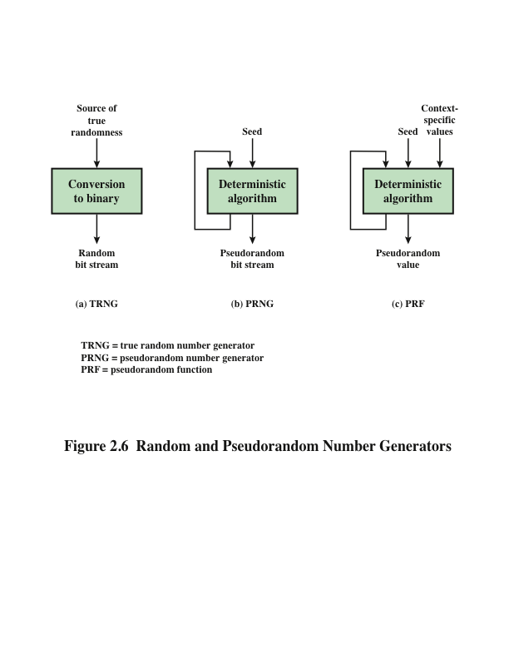
Notes:
Cryptographic applications typically make use of algorithmic techniques for random
number generation. These algorithms are deterministic and therefore produce
sequences of numbers that are not statistically random. However, if the algorithm is
good, the resulting sequences will pass many reasonable tests of randomness. Such
numbers are referred to as pseudorandom numbers .
You may be somewhat uneasy about the concept of using numbers generated
by a deterministic algorithm as if they were random numbers. Despite what might be
called philosophical objections to such a practice, it generally works. That is, under
most circumstances, pseudorandom numbers will perform as well as if they were random
for a given use. The phrase “as well as” is unfortunately subjective, but the use
of pseudorandom numbers is widely accepted. The same principle applies in statistical
application, in which a statistician takes a sample of a population and assumes that
the results will be approximately the same as if the whole population were measured.
Figure 2.6 contrasts a true random number generator (TRNG) with two
forms of pseudorandom number generators. A TRNG takes as input a source
that is effectively random; the source is often referred to as an entropy source . In
essence, the entropy source is drawn from the physical environment of the computer
and could include things such as keystroke timing patterns, disk electrical
activity, mouse movements, and instantaneous values of the system clock. The
source, or combination of sources, serves as input to an algorithm that produces
random binary output. The TRNG may simply involve conversion of an analog
source to a binary output. The TRNG may involve additional processing to overcome
any bias in the source.
In contrast, a PRNG takes as input a fixed value, called the seed , and produces
a sequence of output bits using a deterministic algorithm. Typically, as shown in
Figure 2.6, there is some feedback path by which some of the results of the algorithm
are fed back as input as additional output bits are produced. The important
thing to note is that the output bit stream is determined solely by the input value or
values, so that an adversary who knows the algorithm and the seed can reproduce
the entire bit stream.
Figure 2.6 shows two different forms of PRNGs, based on application.
• Pseudorandom number generator: An algorithm that is used to produce an
open-ended sequence of bits is referred to as a PRNG. A common application
for an open-ended sequence of bits is as input to a symmetric stream cipher, as
discussed in the following section.
• Pseudorandom function (PRF): A PRF is used to produce a pseudorandom
string of bits of some fixed length. Examples are symmetric encryption
keys and nonces. Typically, the PRF takes as input a seed plus some context
specific values, such as a user ID or an application ID. A number of examples
of PRFs will be seen throughout this book.
Other than the number of bits produced, there is no difference between a
PRNG and a PRF. The same algorithms can be used in both applications. Both
require a seed and both must exhibit randomness and unpredictability. Furthermore,
a PRNG application may also employ context-specific input.

Slide 98
Algorithm design
Purpose-built algorithms
Designed specifically and solely for the purpose of generating pseudorandom bit streams
Algorithms based on existing cryptographic algorithms
Cryptographic algorithms have the effect of randomizing input
Can serve as the core of PRNGs
Three broad categories of cryptographic algorithms are commonly used to create PRNGs:
Symmetric block ciphers
Asymmetric ciphers
Hash functions and message authentication codes
Notes:
Cryptographic PRNGs have been the subject of much research over the years,
and a wide variety of algorithms have been developed. These fall roughly into two
categories:
• Purpose-built algorithms: These are algorithms designed specifically and
solely for the purpose of generating pseudorandom bit streams. Some of these
algorithms are used for a variety of PRNG applications; several of these are
described in the next section. Others are designed specifically for use in a
stream cipher. The most important example of the latter is RC4, described in
the next section.
• Algorithms based on existing cryptographic algorithms: Cryptographic algorithms
have the effect of randomizing input. Indeed, this is a requirement of
such algorithms. For example, if a symmetric block cipher produced ciphertext
that had certain regular patterns in it, it would aid in the process of cryptanalysis.
Thus, cryptographic algorithms can serve as the core of PRNGs.
Three broad categories of cryptographic algorithms are commonly used to
create PRNGs:
—Symmetric block ciphers
—Asymmetric ciphers
—Hash functions and message authentication codes
Any of these approaches can yield a cryptographically strong PRNG. A
purpose-built algorithm may be provided by an operating system for general use.
For applications that already use certain cryptographic algorithms for encryption or
authentication, it makes sense to re-use the same code for the PRNG. Thus, all of
these approaches are in common use.

Slide 99
Real World Stream Cipher
RC4
Used in WEP for wireless network security
One option in TLS/HTTPS for encrypting web traffic
Not recommend to use anymore
A5/1
Use for encrypting GSM phone data and conversations
NSA is known to be routinely breaking it

Slide 100
Stream Cipher design considerations
The encryption sequence should have a large period
The longer the period of repeat, the more difficult it will be to do cryptanalysis
The keystream should approximate the properties of a true random number stream as close as possible
The more random-appearing the keystream is, the more randomized the ciphertext is, making cryptanalysis more difficult
The pseudorandom number generator is conditioned on the value of the input key
To guard against brute-force attacks, the key needs to be sufficiently long
With current technology, a key length of at least 128 bits is desirable
Notes:
[KUMA97] lists the following important design considerations for a stream
cipher.
1. The encryption sequence should have a large period. A pseudorandom number
generator uses a function that produces a deterministic stream of bits that
eventually repeats. The longer the period of repeat, the more difficult it will
be to do cryptanalysis.
2. The keystream should approximate the properties of a true random number
stream as close as possible. For example, there should be an approximately
equal number of 1s and 0s. If the keystream is treated as a stream of bytes,
then all of the 256 possible byte values should appear approximately equally
often. The more random-appearing the keystream is, the more randomized the
ciphertext is, making cryptanalysis more difficult.
3. Note from Figure 2.7 that the output of the pseudorandom number generator
is conditioned on the value of the input key. To guard against brute-force
attacks, the key needs to be sufficiently long. The same considerations as apply
for block ciphers are valid here. Thus, with current technology, a key length of
at least 128 bits is desirable.
With a properly designed pseudorandom number generator, a stream cipher
can be as secure as block cipher of comparable key length. A potential advantage
of a stream cipher is that stream ciphers that do not use block ciphers as a building
block are typically faster and use far less code than do block ciphers. The example
in this chapter, RC4, can be implemented in just a few lines of code. In recent years,
this advantage has diminished with the introduction of AES, which is quite efficient
in software. Furthermore, hardware acceleration techniques are now available for
AES. For example, the Intel AES Instruction Set has machine instructions for one
round of encryption and decryption and key generation. Using the hardware instructions
results in speedups of about an order of magnitude compared to pure
software implementations [XU10].
One advantage of a block cipher is that you can reuse keys. In contrast, if two
plaintexts are encrypted with the same key using a stream cipher, then cryptanalysis
is often quite simple [DAWS96]. If the two ciphertext streams are XORed together,
the result is the XOR of the original plaintexts. If the plaintexts are text strings,
credit card numbers, or other byte streams with known properties, then cryptanalysis
may be successful.
For applications that require encryption/decryption of a stream of data (such
as over a data-communications channel or a browser/Web link), a stream cipher
might be the better alternative. For applications that deal with blocks of data (such
as file transfer, e-mail, and database), block ciphers may be more appropriate.
However, either type of cipher can be used in virtually any application.

Slide 101
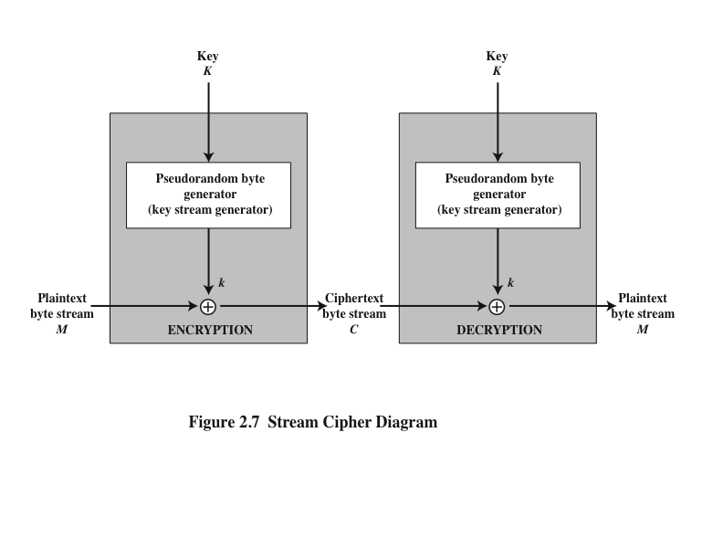
Notes:
A typical stream cipher encrypts plaintext one byte at a time, although a stream
cipher may be designed to operate on one bit at a time or on units larger than a
byte at a time. Figure 2.7 is a representative diagram of stream cipher structure.
In this structure, a key is input to a pseudorandom bit generator that produces a
stream of 8-bit numbers that are apparently random. The pseudorandom stream is
unpredictable without knowledge of the input key and has an apparently random
character. The output of the generator, called a keystream , is combined one byte at
a time with the plaintext stream using the bitwise exclusive-OR (XOR) operation.

Slide 102
Stream Cipher Encryption Example
Key (128-bits)
Keystream (KS)
Plaintext Data (PT)
RC4
01001010…1001010
00010011…1101010
XOR
CT
=
⊕
KS
PT
01011001…0100000
Ciphertext (CT)

Slide 103
Stream Cipher Decryption Example
Key (128-bits)
Keystream (KS)
Ciphertext (CT)
RC4
01001010…1001010
01011001…0100000
XOR
PT
=
⊕
KS
CT
00010011…1101010
Plaintext Data (PT)

Slide 104
Using XOR with a Stream Cipher
Using XOR for encryption:
CT = KS ⊕ PT
Using XOR for decryption:
PT = KS ⊕ CT

Slide 105
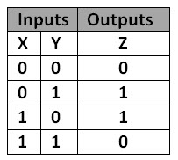
Example of XOR in Stream Cipher
Encrypt
Plaintext (PT) = 0110
Keystream (KS) = 1100
Ciphertext (CT) = 1010
Decrypt
Ciphertext (CT) = 1010
Keystream (KS) = 1100
Plaintext (PT) = 0110

Slide 106
RC4 algorithm
A stream cipher designed in 1987 by Ron Rivest for RSA Security
It is a variable key-size stream cipher with byte-oriented operations
The algorithm is based on the use of a random permutation
Is used in the Secure Sockets Layer/Transport Layer Security (SSL/TLS) standards that have been defined for communication between Web browsers and servers
Also used in the Wired Equivalent Privacy (WEP) protocol and the newer WiFi Protected Access (WPA) protocol that are part of the IEEE 802.11 wireless LAN standard
Notes:
RC4 is a stream cipher designed in 1987 by Ron Rivest for RSA Security. It is
a variable key-size stream cipher with byte-oriented operations. The algorithm
is based on the use of a random permutation. Analysis shows that the period of
the cipher is overwhelmingly likely to be greater than 10100 [ROBS95a]. Eight
to sixteen machine operations are required per output byte, and the cipher can
be expected to run very quickly in software. RC4 is used in the Secure Sockets
Layer/Transport Layer Security (SSL/TLS) standards that have been defined
for communication between Web browsers and servers. It is also used in the
Wired Equivalent Privacy (WEP) protocol and the newer WiFi Protected Access
(WPA) protocol that are part of the IEEE 802.11 wireless LAN standard. RC4
was kept as a trade secret by RSA Security. In September 1994, the RC4 algorithm
was anonymously posted on the Internet on the Cypherpunks anonymous
remailers list.
The RC4 algorithm is remarkably simple and quite easy to explain. A
variable-length key of from 1 to 256 bytes (8 to 2048 bits) is used to initialize a
256-byte state vector S, with elements S[0], S[1], . . . , S[255]. At all times, S contains
a permutation of all 8-bit numbers from 0 through 255. For encryption and decryption,
a byte k (see Figure 2.7) is generated from S by selecting one of the 255 entries
in a systematic fashion. As each value of k is generated, the entries in S are once
again permuted.
A number of papers have been published analyzing methods
of attacking RC4 (e.g., [KNUD98], [FLUH00], [MANT01]). None of these
approaches is practical against RC4 with a reasonable key length, such as 128 bits.
A more serious problem is reported in [FLUH01]. The authors demonstrate that
the WEP protocol, intended to provide confidentiality on 802.11 wireless LAN
networks, is vulnerable to a particular attack approach. In essence, the problem is
not with RC4 itself but the way in which keys are generated for use as input to RC4.
This particular problem does not appear to be relevant to other applications using
RC4 and can be remedied in WEP by changing the way in which keys are generated.
This problem points out the difficulty in designing a secure system that involves
both cryptographic functions and protocols that make use of them.

Slide 107
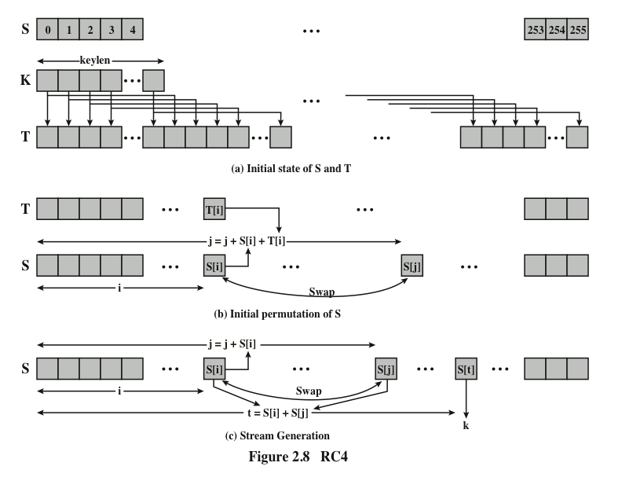
Notes:
Figure 2.8 illustrates the RC4 logic.

Slide 108
summary
Symmetric encryption principles
Cryptography
Cryptanalysis
Feistel cipher structure
Symmetric block encryption algorithms
Data encryption standard
Triple DES
Advanced encryption standard
Random and pseudorandom numbers
The use of random numbers
TRNGs, PRNGs, PRFs
Algorithm design
Stream ciphers and RC4
Stream cipher structure
RC4 algorithm
Cipher block modes of operation
ECB
CBC
CFB
CTR
Notes:
Chapter 2 summary.

Slide 109
Further Reading
Chapter 2 of the textbook: Network Security Essentials-Application & Standards” by William Stallings 6th Edition, PrenticeHall, 2017

